Slide 1
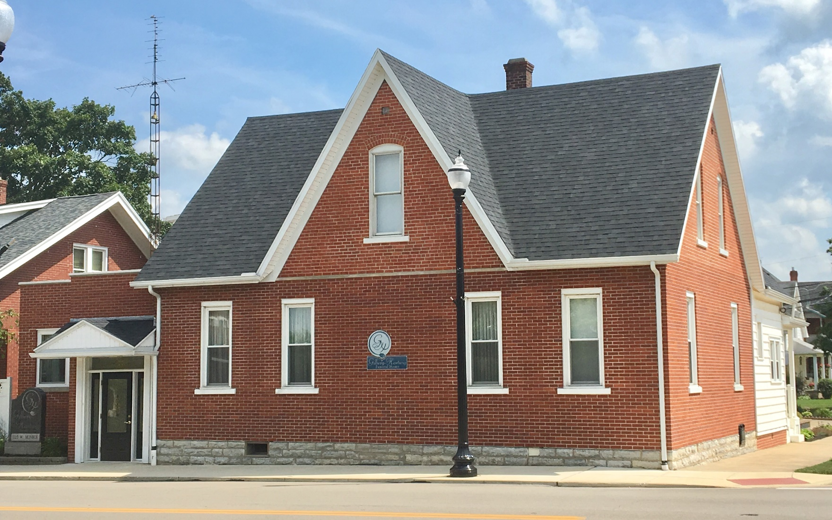
Gilberg- Hartwig Funeral Home
Family serving family since 1929

Slide 2
We are here to help you...
Gilberg-Hartwig Funeral Home is here to provide you with the best care when you need it the most. Honest, respectful, dignified care – like you would expect from your own family.
We realize the struggles that come with the loss of a loved one, and so we work with each family that we serve to provide quality services and merchandise at an affordable price. We want to work with you to provide the personalized service selections that your loved one deserves to honor their memory.

Slide 3
Cremation Choices
Choosing cremation offers several choices for service and memorialization. The following considerations will help you determine the type of event that would be most meaningful to you, your family, and friends.
~Do you prefer to offer friends and extended family the opportunity to say goodbye and offer their love and support with a public viewing or memorial service?
~Do you prefer to conduct ceremonial services at a church or place of worship?
~If family and friends are coming from a distance, do you prefer to arrange for a memorial service following the cremation?
Whatever your preference, we want to work with you to create an appropriate tribute. To help simplify the planning and arrangement process, the packages on the following pages represent the most popular choices for our client families who select cremation.

Slide 4
#1 – “Traditional” Cremation Package
FULL VISITATION AND FUNERAL SERVICE WITH CREMATION CASKET, CREMATION, URN & URN VAULT
This Package Includes:
Removal of Remains and Transportation to the Crematory
Basic Services of the Funeral Director and Staff
Embalming & Other Preparation of the Body
Use of Facilities and Staff for Several Hours of Visitation
Use of Facilities and Staff for Funeral Service
Use of Hearse (Funeral Coach) within 30 miles
Register Book / Acknowledgement Cards / Memorial Folders (Including Printing)
Cremation Fee / Cremation Permit
Batesville Lynx Cremation Casket*
Choice of Cremation Urn ($395 level*)
Universal Urn Vault*
* You may substitute another casket, urn, or urn vault for the ones listed in this package.
Package cost will then be adjusted based on your selections.
Disclosure: If you want to arrange a direct cremation, you can use an alternative container. Alternative containers encase the body and can be made of materials like fiberboard or composite materials (with or without an outside covering). The containers we provide are made of heavy cardboard, fiberboard, and composite materials.
Prices effective January 2, 2022, but are subject to change without notice.
$8,303
*Sales tax, Cemetery Charges, and Cash Advance Items Extra

Slide 5
#2 – “Traditional” (Rental) Cremation Package
FULL VISITATION AND FUNERAL SERVICE WITH RENTAL CASKET, CREMATION, URN & URN VAULT
This Package Includes:
Removal of Remains and Transportation to the Crematory
Basic Services of the Funeral Director and Staff
Embalming & Other Preparation of the Body
Use of Facilities and Staff for Several Hours of Visitation
Use of Facilities and Staff for Funeral Service
Use of Hearse (Funeral Coach) within 30 miles
Register Book / Acknowledgement Cards / Memorial Folders (Including Printing)
Cremation Fee / Cremation Permit
Use of Oak Rental Cremation Casket
Choice of Cremation Urn ($395 level*)
Universal Urn Vault*
* You may substitute another urn or urn vault for the ones listed in this package.
Package cost will then be adjusted based on your selections.
Disclosure: If you want to arrange a direct cremation, you can use an alternative container. Alternative containers encase the body and can be made of materials like fiberboard or composite materials (with or without an outside covering). The containers we provide are made of heavy cardboard, fiberboard, and composite materials.
Prices effective January 2, 2022, but are subject to change without notice.
$7,903
Sales tax, Cemetery Charges, and Cash Advance Items Extra

Slide 6
#3 – “Semi-Traditional” Cremation Package
IMMEDIATE CREMATION WITH FULL VISITATION, FUNERAL SERVICE, USING A CASKET, URN & URN VAULT
This Package Includes:
Removal of Remains and Transportation to the Crematory
Basic Services of the Funeral Director and Staff
Use of Facilities and Staff for Several Hours of Visitation
Use of Facilities and Staff for Funeral Service
Use of Hearse (Funeral Coach) within 30 miles
Use of Symbolic Casket for Visitation and Funeral Service
Register Book / Acknowledgement Cards / Memorial Folders (Including Printing)
Cremation Fee / Cremation Permit
Minimum Cremation Container*
Choice of Cremation Urn ($395 level*)
Universal Urn Vault*
*You may substitute another casket, urn or urn vault for the ones listed in this package.
Package cost will then be adjusted based on your selections.
Disclosure: If you want to arrange a direct cremation, you can use an alternative container. Alternative containers encase the body and can be made of materials like fiberboard or composite materials (with or without an outside covering). The containers we provide are made of heavy cardboard, fiberboard, and composite materials.
Prices effective January 1, 2022, but are subject to change without notice.
$5,598
Sales tax, Cemetery Charges, and Cash Advance Items Extra

Slide 7
#4 – “Memorial” Cremation Package
IMMEDIATE CREMATION WITH VISITATION, MEMORIAL SERVICE, URN & URN VAULT
This Package Includes:
Removal of Remains and Transportation to the Crematory
Basic Services of the Funeral Director and Staff
Use of Facilities and Staff for Several Hours of Visitation
Use of Facilities and Staff for Memorial Service
Register Book / Acknowledgement Cards / Memorial Folders (Including Printing)
Cremation Fee / Cremation Permit
Minimum Cremation Container*
Choice of Cremation Urn ($395 level*)
Universal Urn Vault*
*You may substitute another casket, urn or urn vault for the ones listed in this package.
Package cost will then be adjusted based on your selections.
Disclosure: If you want to arrange a direct cremation, you can use an alternative container. Alternative containers encase the body and can be made of materials like fiberboard or composite materials (with or without an outside covering). The containers we provide are made of heavy cardboard, fiberboard, and composite materials.
Prices effective January 2, 2022, but are subject to change without notice.
$5,203
*Sales tax, Cemetery Charges, and Cash Advance Items Extra

Slide 8
#5 – “Tribute” Cremation Package
IMMEDIATE CREMATION WITH LIMITED VISITATION, AND MEMORIAL SERVICE
This Package Includes:
Removal of Remains and Transportation to the Crematory
Basic Services of the Funeral Director and Staff
Use of Facilities and Staff for 1 Hour of Visitation & Memorial Service
Register Book / Acknowledgement Cards / Memorial Folders (Including Printing)
Cremation Fee / Cremation Permit
Minimum Cremation Container*
Choice of Cremation Urn ($395 level*)
* You may substitute another casket, urn, or urn vault for the ones listed in this package.
Package cost will then be adjusted based on your selections.
Disclosure: If you want to arrange a direct cremation, you can use an alternative container. Alternative containers encase the body and can be made of materials like fiberboard or composite materials (with or without an outside covering). The containers we provide are made of heavy cardboard, fiberboard, and composite materials.
Prices effective January 1, 2022, but are subject to change without notice.
$4,073
*Sales tax, Cemetery Charges, and Cash Advance Items Extra

Slide 9
#6 – “Graveside” Cremation Package
IMMEDIATE CREMATION FOLLOWED BY A GRAVESIDE CEREMONY
This Package Includes:
Removal of Remains and Transportation to the Crematory
Basic Services of the Funeral Director and Staff
Cremation Fee / Cremation Permit
Minimum Cremation Container*
Choice of Cremation Urn ($395 level*)
Use of Staff and Equipment for Graveside Services
*You may substitute another casket, urn, or urn vault for the ones listed in this package.
Package cost will then be adjusted based on your selections.
Disclosure: If you want to arrange a direct cremation, you can use an alternative container. Alternative containers encase the body and can be made of materials like fiberboard or composite materials (with or without an outside covering). The containers we provide are made of heavy cardboard, fiberboard, and composite materials.
Prices effective January 1, 2022, but are subject to change without notice.
$3,593
*Sales tax, Cemetery Charges, and Cash Advance Items Extra

Slide 10
#7 – “Direct” Cremation Package
IMMEDIATE CREMATION WITHOUT VISITATION OR CEREMONY
This Package Includes:
Removal of Remains and Transportation to the Crematory
Basic Services of the Funeral Director and Staff
Cremation Fee / Cremation Permit
Minimum Cremation Container*
Choice of Cremation Urn ($395 level*)
*You may substitute another casket, urn, or urn vault for the ones listed in this package.
Package cost will then be adjusted based on your selections.
Disclosure: If you want to arrange a direct cremation, you can use an alternative container. Alternative containers encase the body and can be made of materials like fiberboard or composite materials (with or without an outside covering). The containers we provide are made of heavy cardboard, fiberboard, and composite materials.
Prices effective January 1, 2022, but are subject to change without notice.
$3,343
*Sales tax, Cemetery Charges, and Cash Advance Items Extra

Slide 11
Casket selection
Gilberg-Hartwig Funeral Home

Slide 12
Choosing a Cremation Casket
Weather you choose the comfort and ritual of the traditional visitation and funeral service, or a more personalized gathering of family and friends, our funeral home is proud to offer a range of caskets specially designed for cremation.
The purpose of a cremation casket is to shelter your loved one and offer an appropriate dignified resting place for the presentation and disposition of the body.
Cremation caskets are available in a variety of styles and colors, and are typically crafted from wood. Several styles are shown on the next page. There are others to chose from.

Slide 13
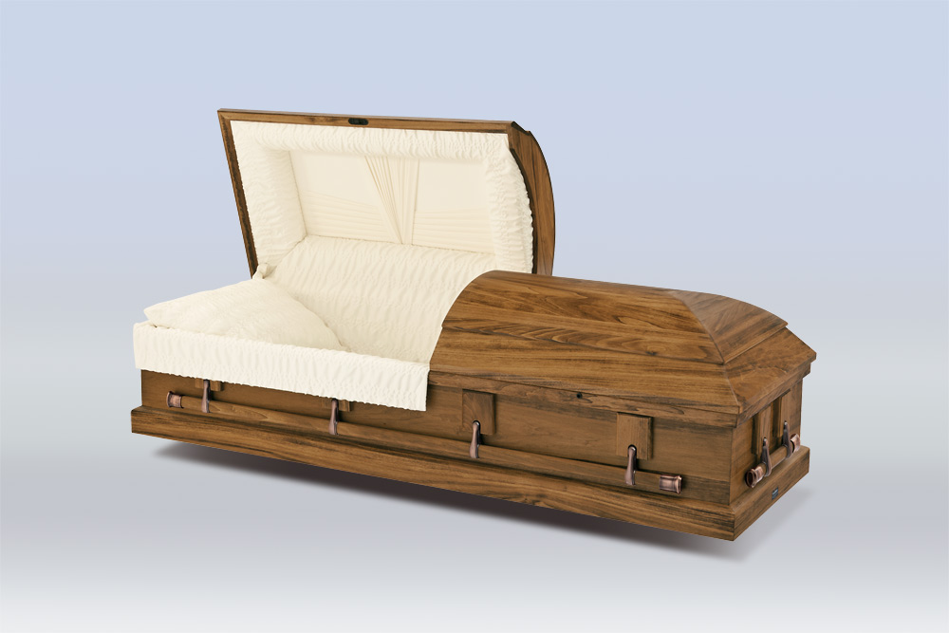
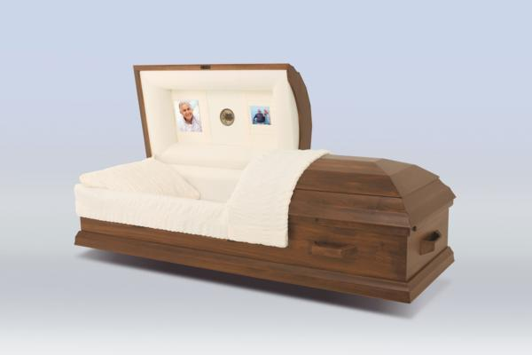
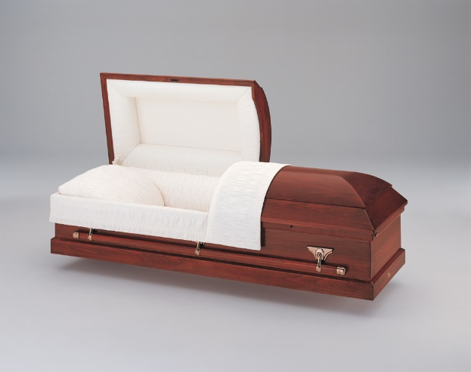
Cremation Caskets

Slide 14
Urn Selection
Gilberg-Hartwig Funeral Home

Slide 15
Choosing a Final Resting Place
Cremation offers a variety of dignified choices regarding how and where to forever honor your loved one:
Home – Urns for keeping in your private residence
Niche – Urns for placement in the niche of a mausoleum
Burial – Urns crafted to conform to placement in a cemetery
Scattering – Urns specially designed to facilitate scattering
You can take comfort in your personal choice for memorializing a loved one. Many urns can be used for several types of final resting place choices.

Slide 16
Home - when the journey leads back home
Find comfort by keeping your loved one close by in your own home. We offer a variety of designs, colors, materials, and finishes to appropriately honor their memory while integrating into the décor of your home.

Slide 17
Niche – a place and time to reflect on one’s journey
This is the perfect choice for creating a lasting memorial for family and friends to visit as desired. Typically located in a mausoleum or church, urns can be sealed out of sight or behind glass.

Slide 18
Burial – put the cares of life’s journey to rest
Cremation remains a viable alternative even when tradition calls for cemetery burial. We can help to arrange for ground burial and committal services at the cemetery of your choice

Slide 19
Scattering – the journey takes flight, scattering to the wind
We offer urns uniquely designed to celebrate scattering at a special place or time. We can help facilitate this reverent event, honoring your wishes while keeping in accordance with local regulations.

Slide 20
Standard Urn Selections
Highland
*Solid Maple Construction
*Westminster Chime
Blue Sapphire
*Cloisonné
*Floral Motif in shades of blue

Slide 21
Standard Urn Selections
Lodi
*Stainless Steel Construction
*Ideal for Personalized Engraving
Amphora Violet *Made of Hand-blown Glass
*(also available in Aqua)

Slide 22
Standard Urn Selections
Venice
*Nickel Plated Bronze
Avon
*Solid Cherry Construction
*(also available in double capacity)

Slide 23
Standard Urn Selections
Wave Gray
*Made of Solid Marble
Autumn Leaves
*Cloisonné Construction
*Brilliant colors of reds and oranges

Slide 24
Standard Urn Selections
Willow
*Kiln –Fired Ceramic
*Hand Pained in Natural Hues
Milano Pink
*Cast Bronze

Slide 25
Standard Urn Selections
Olympus Cultured Marble
*Made of Cultured Marble
*(also available in Sand, Navy, and Onyx)
Walnut Scattering Urn
*Solid Walnut Construction
* Sliding lid for easy scattering

Slide 26
Standard Urn Selections
Solitude with Praying Hands
*Sheet Bronze Construction
*Can be personalized with appliques or engraving
Serenity with Wreath
*Sheet Bronze Construction
*Cast Bronze wreath, top, and base

Slide 27
Ask us about different urn choices...
There are hundreds of different urn options available in today’s market. Urns come in many different styles, colors, and materials. We can work with you to find an urn that is perfect to memorialize your loved one.

Slide 28
Thank you for allowing us to help you
Celebrate Life’s Journey

Slide 29
Gilberg-Hartwig Funeral Home
225 W. Monroe Street
New Bremen, Ohio 45869
419-629-2147
Office@gilberghartwigfh.com

