Slide 1
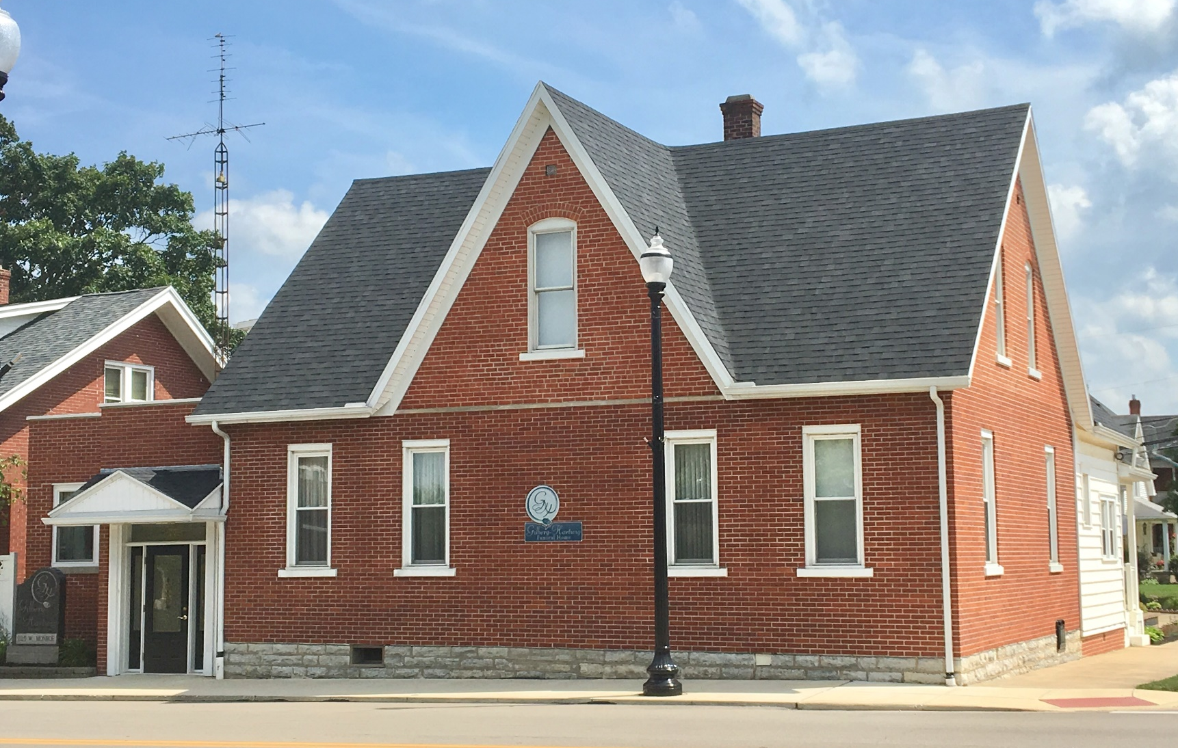
Gilberg- Hartwig Funeral Home
Family serving family since 1929

Slide 2
#1 – Traditional Funeral Service Package
FULL VISITATION WITH FUNERAL SERVICE AND GRAVESIDE SERVICES (2 Days)
This Package Includes:
Basic Services of the Funeral Director and Staff
Removal of Remains
Embalming & Other Preparation of the Body
Use of Facilities and Staff for a Day of Visitation (Day Prior to Funeral Service)
Use of Facilities and Staff for Full Funeral Service
Use of Hearse (Funeral Coach) within 30 Miles
Batesville O61“Cashmere” 18 Gauge Steel Casket*
Register Book / Acknowledgement Cards / Memorial Folders (Including Printing)
Wilbert Venetian Outer Burial Container*
Burial Permit
  *You may substitute another Casket or Outer Burial Container for the ones listed in this package.
  Package cost will then be adjusted based on your selections.
  Prices effective March 1, 2022, but are subject to change without notice.
$10,863
*Sales tax, Cemetery Charges, and Cash Advance Items Extra

Slide 3
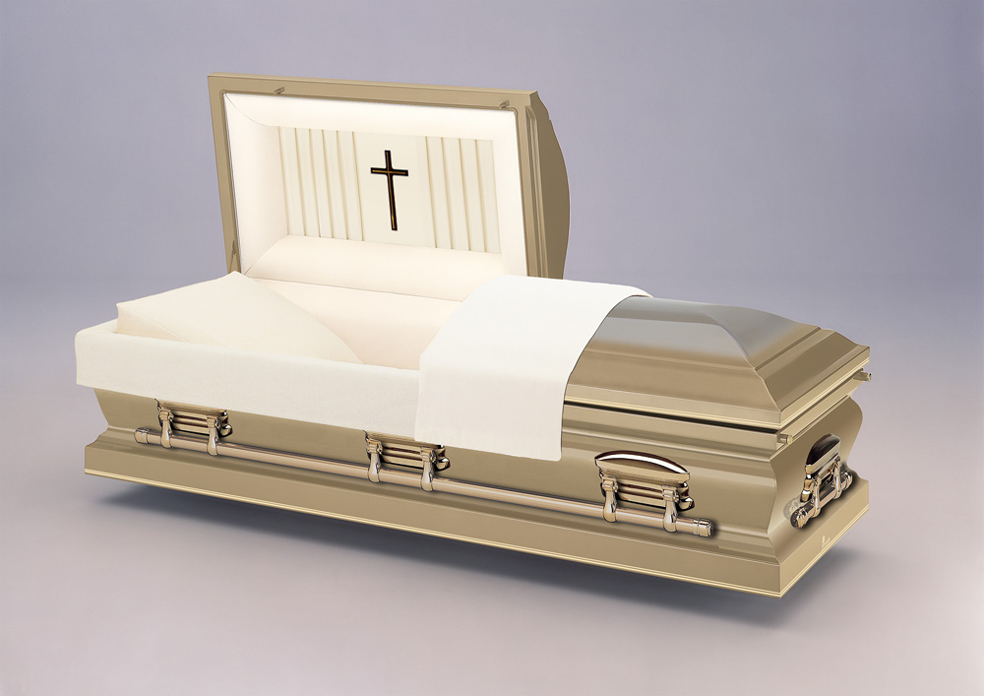
O61 Cashmere
*18 Gauge Steel Construction
*Champaign Sierra Interior
*Swing-Bar Hardware
*LifeSymbols Medallion Option

Slide 4
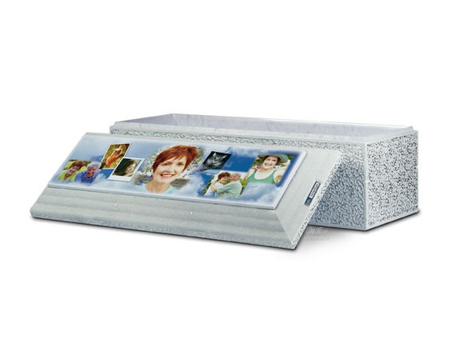
Venetian - Basic Plus Strength
Single Reinforced Concrete lined with High Impact ABS Plastic
Personalization Options Available
Included in Packages 1,2, and 3

Slide 5
#2 – Semi-Traditional Funeral Service Package
LIMITED VISITATION WITH FUNERAL SERVICE AND GRAVESIDE SERVICES (1 Day)
This Package Includes:
Basic Services of the Funeral Director and Staff
Removal of Remains
Embalming & Other Preparation of the Body
Use of Facilities and Staff for Two Hours of Visitation (Immediately Before Funeral Service)
Use of Facilities and Staff for Full Funeral Service
Use of Hearse (Funeral Coach) within 30 Miles
Batesville O61“Cashmere” 18 Gauge Steel Casket*
Register Book / Acknowledgement Cards / Memorial Folders (Including Printing)
Wilbert Venetian Outer Burial Container*
Burial Permit
  *You may substitute another Casket or Outer Burial Container for the ones listed in this package.
  Package cost will then be adjusted based on your selections.
  Prices effective March 1, 2022, but are subject to change without notice.
$10,713
*Sales tax, Cemetery Charges, and Cash Advance Items Extra

Slide 6
#3 – Graveside Funeral Service Package
LIMITED FUNERAL SERVICE AT THE GRAVESIDE SERVICES (No Visitation)
This Package Includes:
Basic Services of the Funeral Director and Staff
Removal of Remains
Preparation of the Body for Burial (No Embalming – Only Washing & Disinfecting)
Use of Equipment and Staff for Graveside Services
Use of Hearse (Funeral Coach) within 30 Miles
Batesville O61“Cashmere” 18 Gauge Steel Casket*
Wilbert Venetian Outer Burial Container*
Burial Permit
  *You may substitute another Casket or Outer Burial Container for the ones listed in this package.
  Package cost will then be adjusted based on your selections.
  Prices effective March 1, 2022, but are subject to change without notice.
$9,293
*Sales tax, Cemetery Charges, and Cash Advance Items Extra

Slide 7
#4 – Direct Burial Package
DIRECT BURIAL OF THE BODY WITHOUT ANY PREPERATION, VISITATION, OR CEREMONY
This Package Includes:
Basic Services of the Funeral Director and Staff
Removal of Remains
Use of Hearse (Funeral Coach) within 30 Miles
Batesville NO1“Granite” 18 Gauge Steel Casket*
Wilbert Monticello Outer Burial Container*
Burial Permit
  *You may substitute another Casket or Outer Burial Container for the ones listed in this package.
  Package cost will then be adjusted based on your selections.
  Prices effective January 1, 2022, but are subject to change without notice.
$7,843
*Sales tax, Cemetery Charges, and Cash Advance Items Extra

Slide 8
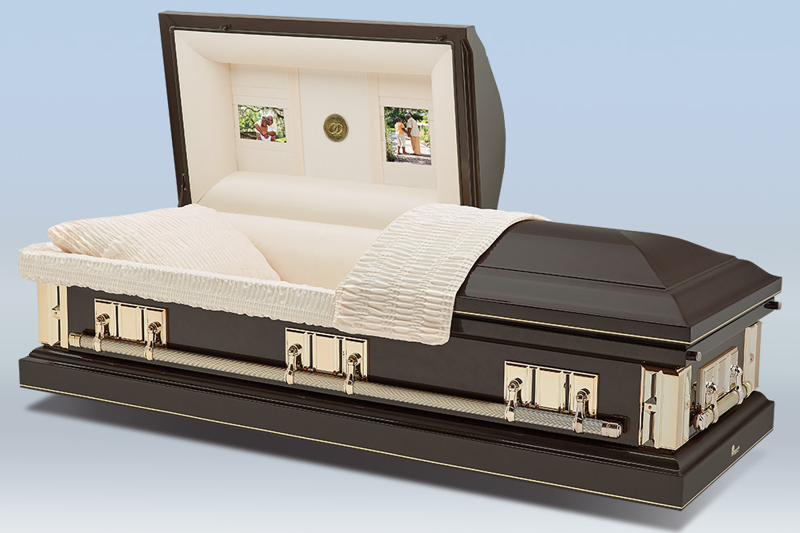
NO1 Granite
*18 Gauge Steel Construction
*Rosetan Crepe Interior
*Swing-Bar Hardware
*LifeSymbols Medallion Option

Slide 9
Casket Selection
Gilberg –Hartwig Funeral Home

Slide 10
Casket Selection
The following are a selection of caskets that we either keep on hand, or are frequently chosen by families we serve. They are made of different materials, have slightly different shapes, and range in different prices. Please keep in mind that many other caskets are available from our suppliers – so if you do not see one that suits your taste, we will help to find one that does.

Slide 11
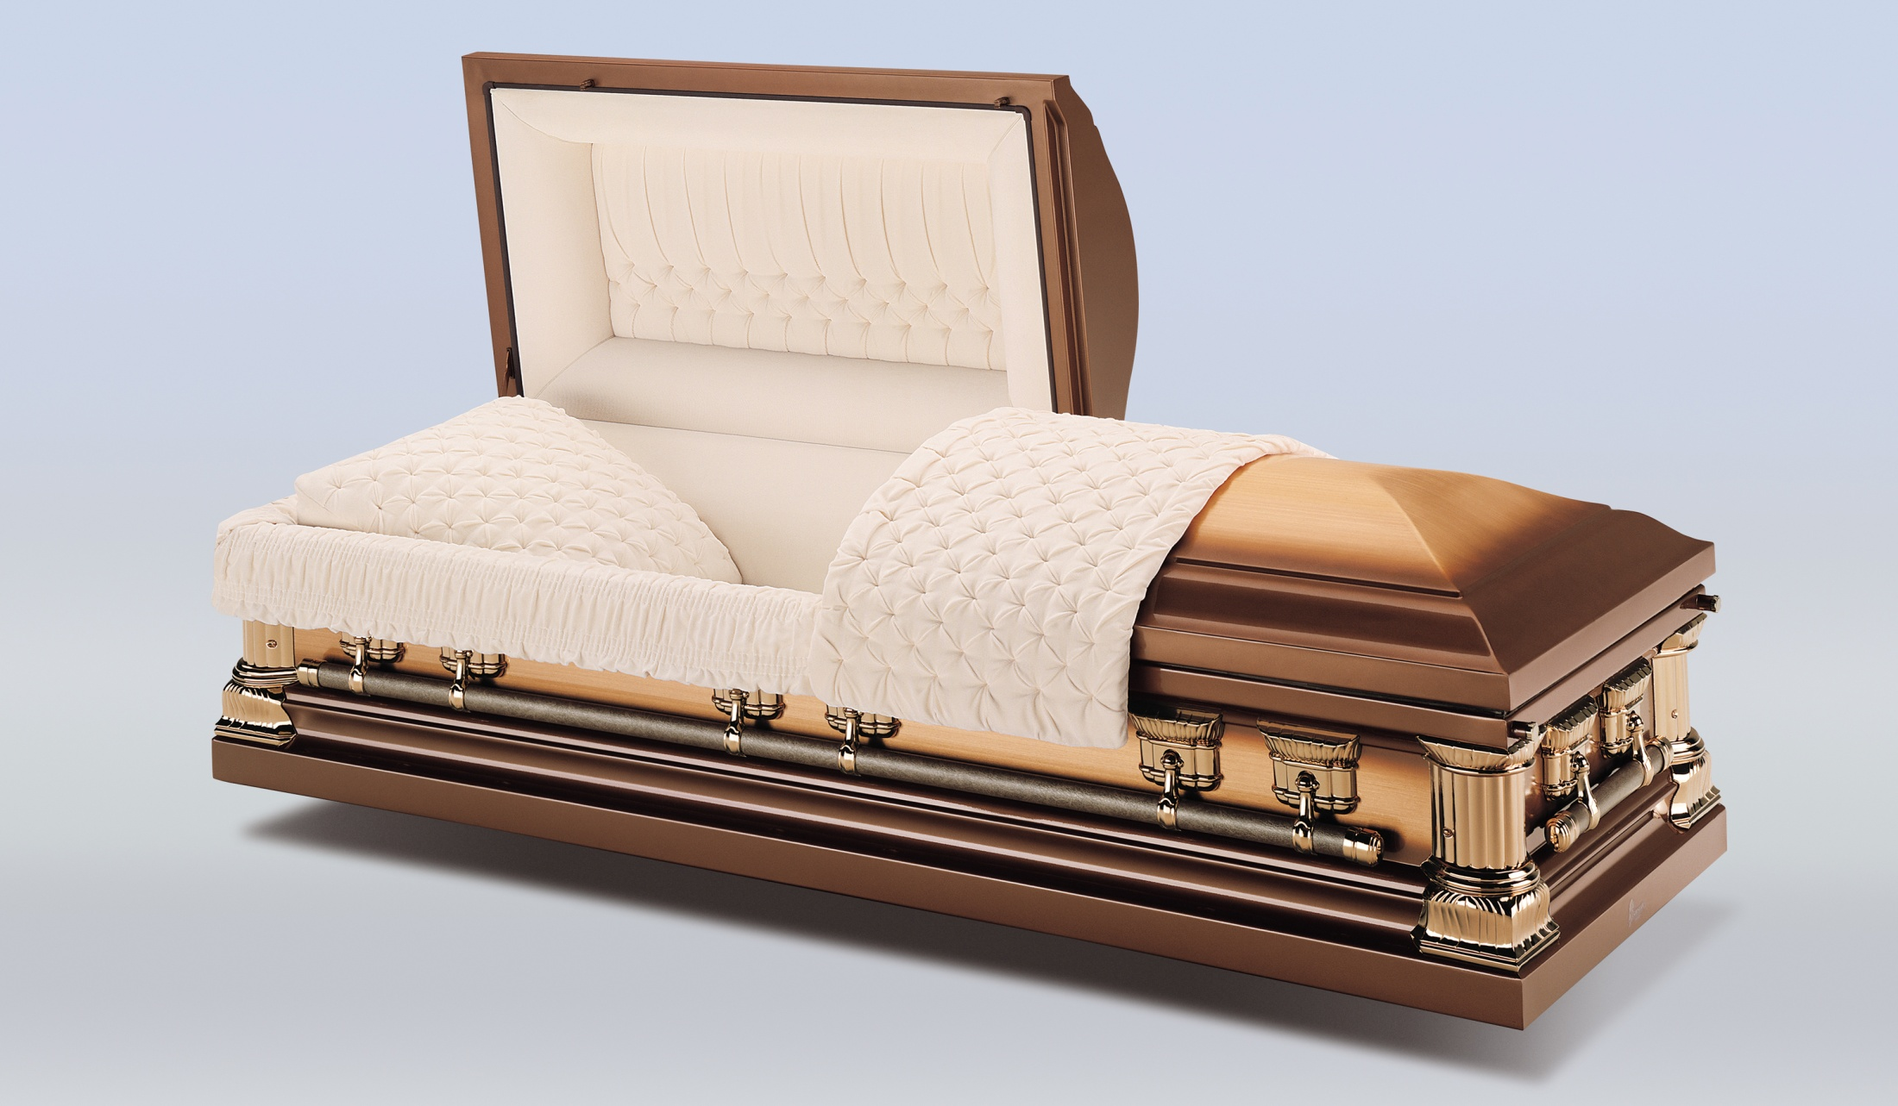
Agean Copper
*Copper Construction
*Champaign Velvet Interior
*Swing-Bar Hardware

Slide 12
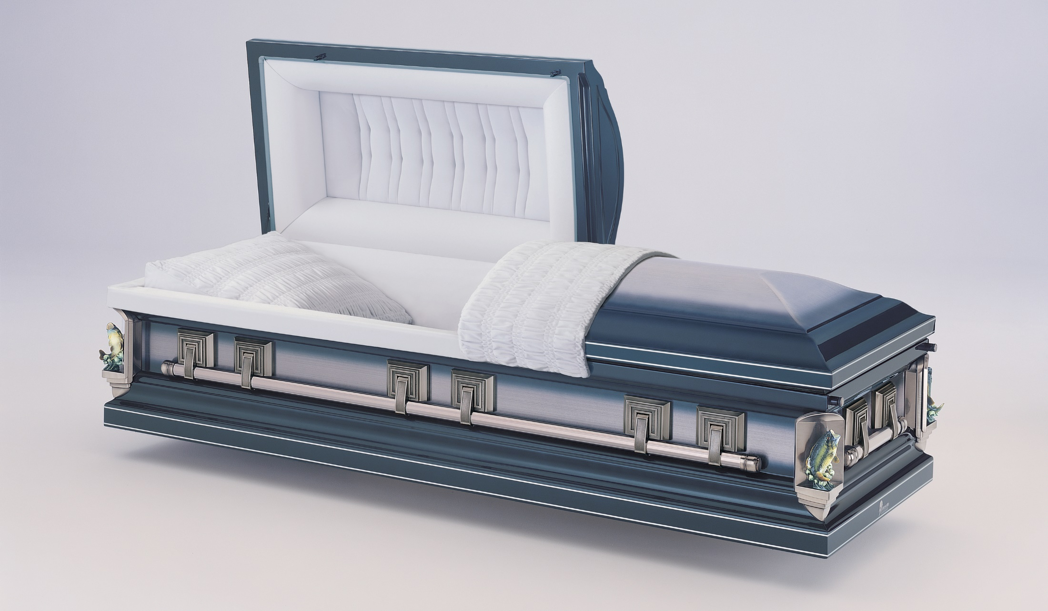
Silver Sapphire Stainless Steel
*Stainless Steel Construction
*Brushed Finish
*Silver Velvet Interior
*Swing-Bar Hardware
*Life Symbols Corners

Slide 13
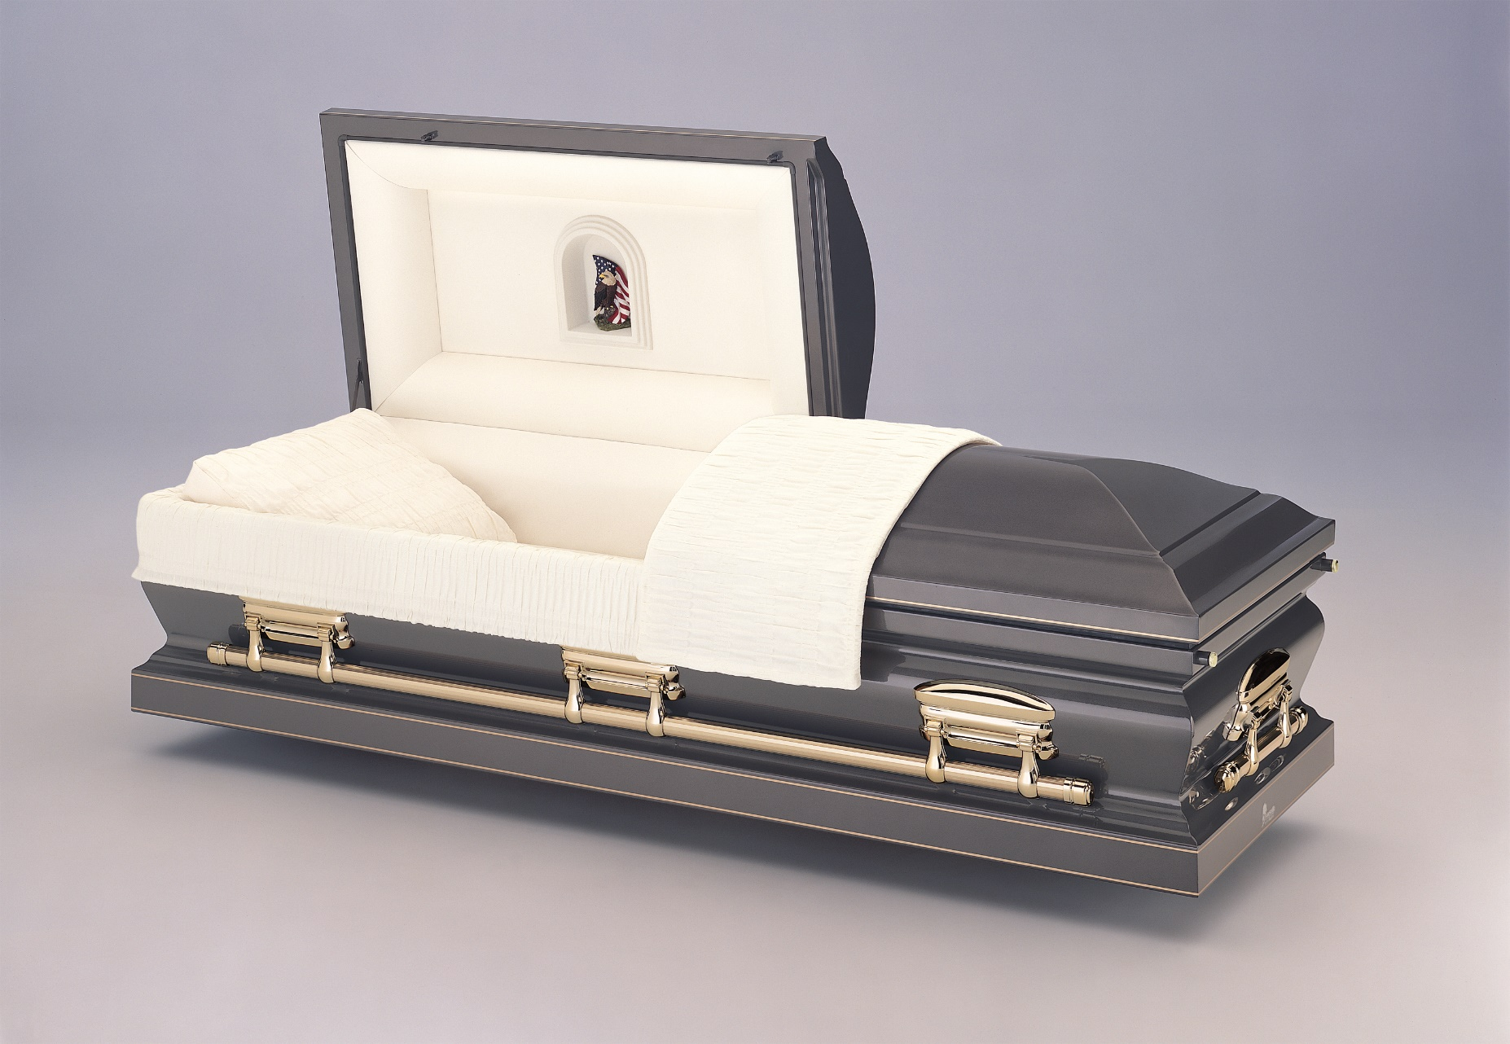
Burnished Silver
*18 Gauge Steel Construction
*Rosetan Crepe Interior
*Swing-Bar Hardware
*LifeSymbol in Cap Panel

Slide 14
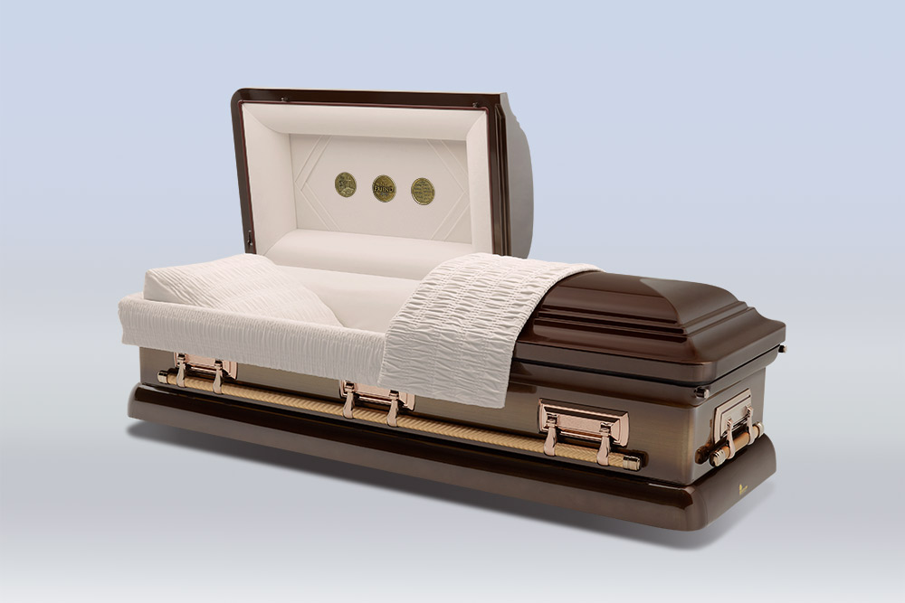
Auburn Sunset
*18 Gauge Steel Construction
*Champaign Velvet Interior
*Swing-Bar Hardware
*LifeSymbols Medallion Option

Slide 15
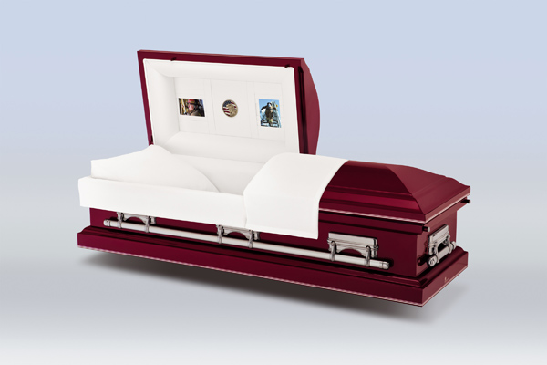
NL1 Claret
*18 Gauge Steel Construction
*Woven Ivory Interior
*Swing-Bar Hardware

Slide 16
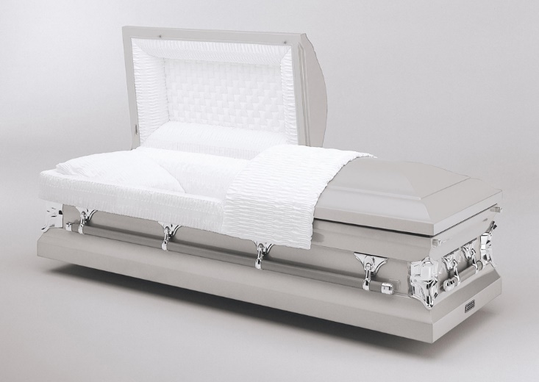
Revere Silver
*20 Gauge Steel Construction
*Ivory Crepe Interior
*Swing-Bar Hardware

Slide 17
Outer Burial Container Selections
Gilberg-Hartwig Funeral Home

Slide 18
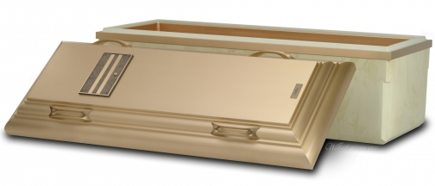
The Wilbert Bronze – Ultimate Strength
Triple Reinforced Concrete incased in High Impact ABS Plastic lined with durable Bronze alloy
Personalization Options Available

Slide 19
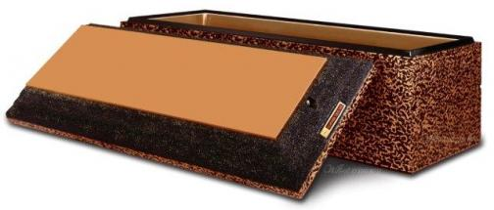
Copper Triune - Premium Strength
Double Reinforced Concrete lined with High Impact ABS Plastic and Copper
Personalization Options Available

Slide 20
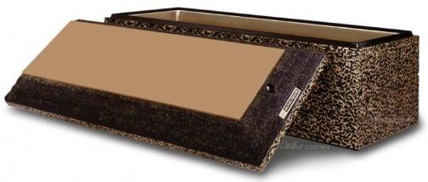
Bronze Triune – Premium Strength
Double Reinforced Concrete lined with High Impact ABS Plastic and Bronze
Personalization Options Available

Slide 21
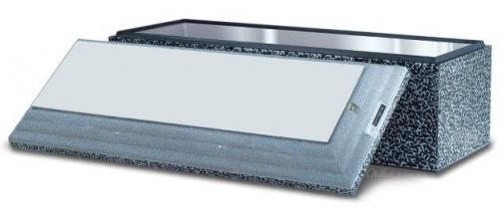
Stainless Steel Triune - Standard Strength
Double Reinforced Concrete lined with High Impact ABS Plastic and Stainless Steel
Personalization Options Available

Slide 22
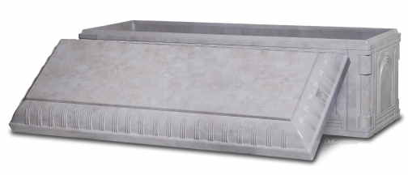
Tribute - Basic Plus Strength
Single Reinforced Concrete completely encased with High Impact ABS Plastic
Finest Basic Plus Strength
Polished simulated marble exterior finish
Personalization Options Available

Slide 23
Venetian - Basic Plus Strength
Single Reinforced Concrete lined with High Impact ABS Plastic
Personalization Options Available

Slide 24
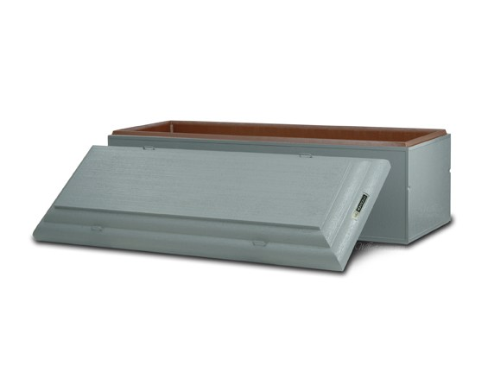
Monticello - Basic Strength
Single Reinforced Concrete with Strentex Plastic Lining
Personalization Options Available

Slide 25
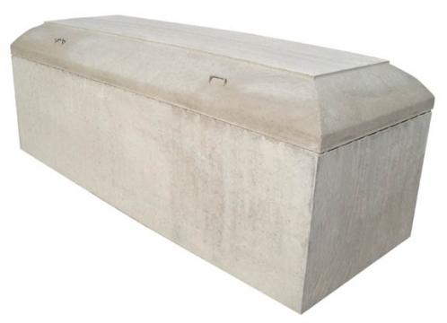
Graveliner
Basic Concrete
Unlined, Non-Sealing, and Non-Protective
Meets Basic Requirements of Cemetery

Slide 26

Thank you for allowing us to help you
Celebrate Life’s Journey

Slide 27
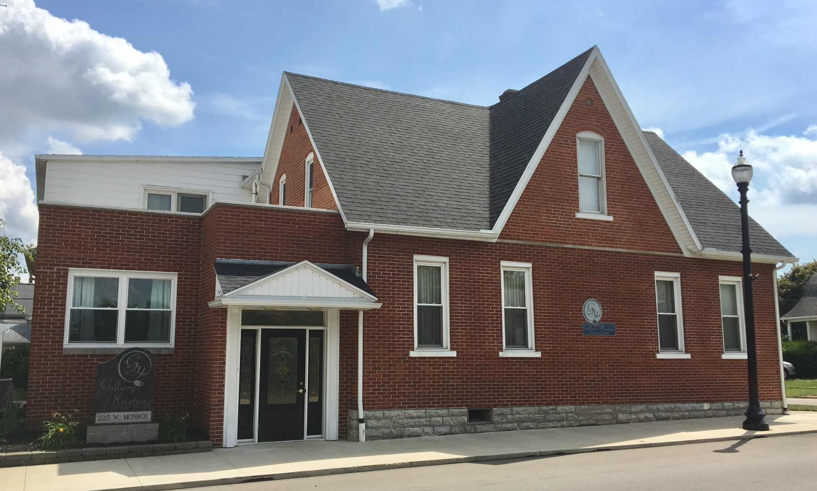
Gilberg-Hartwig Funeral Home
225 W. Monroe Street
New Bremen, Ohio 45869
419-629-2147
Office@gilberghartwigfh.com

